Slide 1
Syllabus 101
Flex Week Fall 2016. August 15, 2016

Slide 2
The course syllabus should:
Serve as the contract or formal agreement between the instructor and the students
Provide a coherent overview of the course and required information (students understand what they are getting into when signing up)
Align with the College’s policies and include information specific to College of Marin; all communications with students should be conducted on College email
Include SLOs that are the same as those found on the course outline of record
Be posted in the College’s Learning Management System (Moodle)
Include a rubric to provide clarity to students about grading for course assignments
Follow the guidelines set forth in the Faculty Handbook
A “learner-centered” syllabus is the goal!

Slide 3
The course syllabus should not…
Be vague or confusing, especially regarding course expectations and grading policies (most grade challenges are due to ambiguities in the grading procedures set forth in the syllabus)
Omit information that is verbally communicated to students (if it isn’t in writing, it won’t matter what was said in class; if a communication is issued verbally in class that is not in the syllabus, discrepancies may arise)
Include policies that aren’t congruent with College policies (for example, “no make-up exams” or “no late assignments”)
Be revised without being formally distributed to enrolled students (flexibility is part of any course and when a syllabus is revised, it should be posted in the learning management system and given to students)
Be subjective or arbitrary

Slide 4
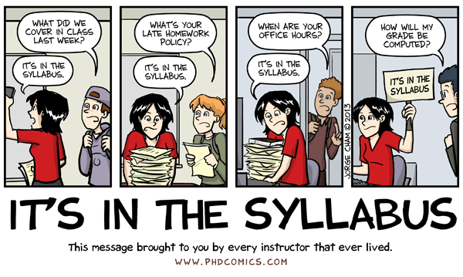
What a best-practice course syllabus accomplishes:
“Sets the climate” for the course and is accessible to all students
Clarity and a thorough, well-presented guide to your course
Students are well-informed, from the start, about course expectations and how to meet them; they are clear on the commitment required to be successful in the class
Fosters responsibility and accountability on the students’ part
Serves to organize both the instructor and students

Slide 5
Developing the Course Syllabus
Developing the syllabus should be a reflective exercise. Keep the following questions in mind when creating your course syllabus:
Is the syllabus organized, reader-friendly, and ADA compliant?
What does the syllabus include to communicate who you are and your teaching philosophy?
How do you communicate your expectations for students such as course goals, student learning outcomes, assignments, and attendance/participation?
Are the course and grading policies clear and without ambiguity?
The purpose of the course syllabus is to provide:
“…the overall pattern of the course so a course does not feel like disjointed assignments and activities, but instead an organized and meaningful journey.”
University of Texas Faculty Innovation Center

Slide 6
Distance Education and ADA Considerations
Communicate frequency and methods of contact
Explain the drop policy and login requirements (e.g. must log in the first day to hold their place)
Describe the requirements for maintaining attendance/participation
Login does not count as LDA – students must submit weekly graded items
Discuss expected time spent per week working in the course
Discuss academic honesty policy
List software and hardware requirements
Provide Moodle Help and technical support information
If using publisher sites, include their tech support

Slide 7
Components of an Accessible Syllabus
In addition to the best practices previously discussed:
Include structure by using heading style features in Word
Provide meaningful alternative text or description to graphics, charts, images, photos, text boxes, or objects
Hyperlink display text should start with the name or title of the linked page, followed by the URL. (e.g., COM homepage http://www.marin.edu/
Note the logical reading order of the screen reader is to read information from left to right and from top to bottom, one line at a time
Tables must indicate header row on all pages and should not be nested

Slide 8
Workshop Group Activity
Activity: Work together to Identify the areas noncompliant areas of a syllabus:
Inaccessible Sample Syllabus 1

Slide 9
Sample Syllabus Discussion
View the Inaccessible Sample Syllabus 1 (with problems noted)

Slide 10
Other considerations...
Students are not the only audience
Syllabi are commonly used for articulation purposes and must impart enough information for faculty reviewers at four-year institutions to make a decision about course comparability
Auditors request syllabi each year via random sampling
Posting your syllabi in Moodle (soon to be Canvas) ensures students can always find it and we can access it for the annual audit, if necessary
Providing a copy to the department assistant is essential: part-time faculty may have moved on and hard to find if we need the syllabus for a course they taught
A course syllabus should be created for each course in a "family" as the SLOs are different
Please refer new full-time and part-time faculty to the Faculty Handbook and other faculty resources to help them with their course syllabi

Slide 11
College of Marin Course Syllabus 101 Guidelines
COM Syllabus Template
COM Syllabus Guidelines

Slide 12
Questions?

